Slide 1

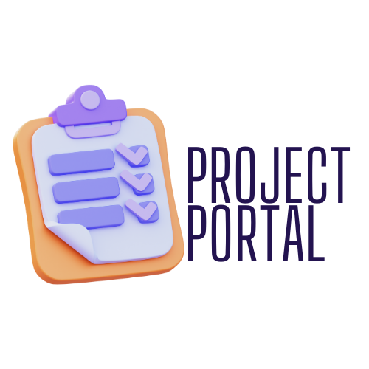

FANTASTIC 5
FINAL PRESENTATION
18 June, 2024
Notes:
Brenna

Slide 2
WELCOME
OVERVIEW
TEAM
REQUIREMENTS
MANAGEMENT
TRENDS
TECH STACK
IMPLEMENTATION
DESIGN
ARCHITECTURE
CLASS DIAGRAM
UI DESIGN
WIREFRAMES
IMPLEMENTATION
SECURITY
CONFIGURATION
DEPLOYMENT
TESTING
Content
Information regarding how we are going to proceed forward with our project
Notes:
Brenna

Slide 3

FANTASTIC 5
Overview
For our project we aimed to develop a user-friendly and engaging online learning platform to support project-based learning. We aimed to provide a smooth experience for our target users, working with the microservice teams to ensure seamless interaction with the backend systems
Notes:
Brenna

Slide 4





FANTASTIC 5
Meet the Team
Brenna Mahn
Team Lead
Natinim Eibrahim
Security Lead
Pinwen Mu
Configuration Lead
Fehmi Baltaci
QA Lead
Brooke Savien Love
Design/Implementation
Notes:
Brenna

Slide 5

Project Requirements
User registration:
As a user I want to be able to register a user account so that I can join the platform
User login:
As a user I want to be able to login to my account so that I can access the platform
Project creation:
As a project lead I want to be able to create a project so that I can initiate new tasks or initiatives
Project Editing:
As a project lead I want to be able to edit a project so that I can keep information up to date.
Project Search:
As a user I want to be able to search for projects so that I can find relevant project information.
Task Assignment and Deadline Setting:
As a project lead I want to be able to assign tasks and set deadlines so that the project progresses smoothly
Team roles and permission management:
As a project lead I want to be able to set team roles and permissions so that I can manage access
Notes:
Brenna

Slide 6
Project Management
Weekly Team Zoom Meetings
We conducted weekly group meetings every Monday at 6pm EST. Additional supplementary meetings were planned as needed to get additional work done. Recordings were made of the meetings and uploaded to our Google Drive.
Meeting Minutes
Meetings Minutes were created to cover what needed to be discussed in each meeting and the key takeaways from our conversations.
Discord Channel
Asynchronous communication was essential for our team as we live in vastly different time zones and have different schedules and availability. We performed frequent check-ins via our Discord chat.
Pivotal Tracker
We used Pivotal Tracker to create tickets based on our project requirements and track their progress throughout our iterations. Link to Pivotal Tracker board.
Google Drive
We used our Google drive to store all our team documents
Notes:
Brenna

Slide 7
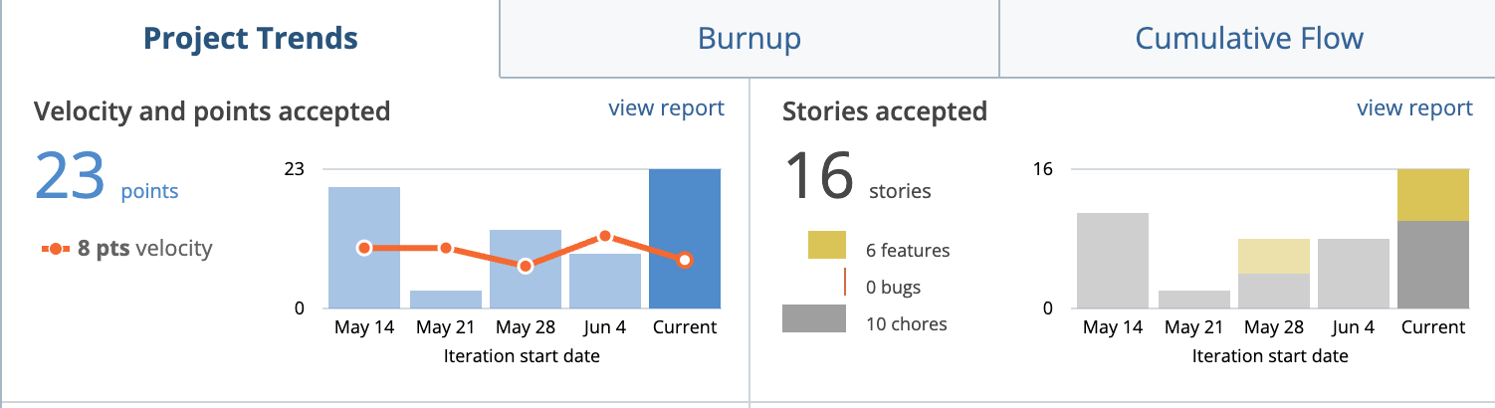
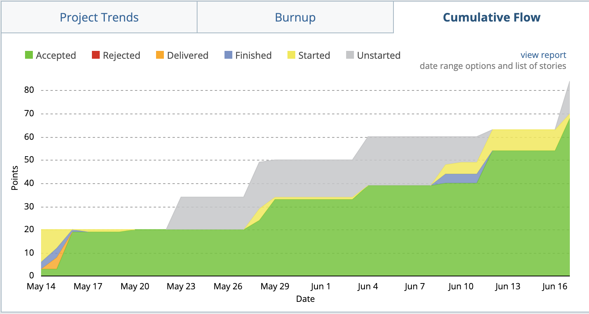
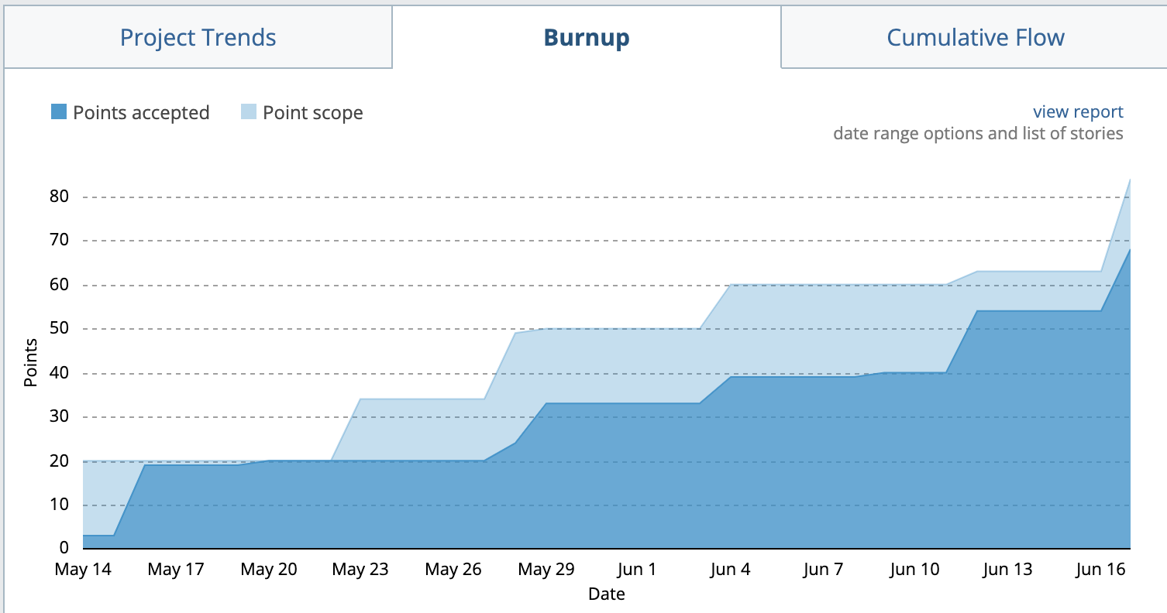
Project Trends

Slide 8
Technology Stack
Frontend Framework: React.js
CSS PreProcessor: SASS
React Component Libraries: Formik
JavaScript Libraries: React Router Dom
Version Control System: Git
Project Management Tool: Pivotal Tracker, Docker
Test Framework: Python-Behave-Selenium, Jest

Slide 9
Introduction & Design Goals
Introduction
Project Portal Frontend UI
Built with React
Integrates with backend services by other teams
Focus on intuitive and user-friendly design
Design Goals
User-Friendliness: Intuitive navigation
Integration: Seamless backend integration
Performance: Fast loading and responsiveness
Scalability: Future expansion ready
Maintainability: Modular and clear code
Notes:
Brooke

Slide 10
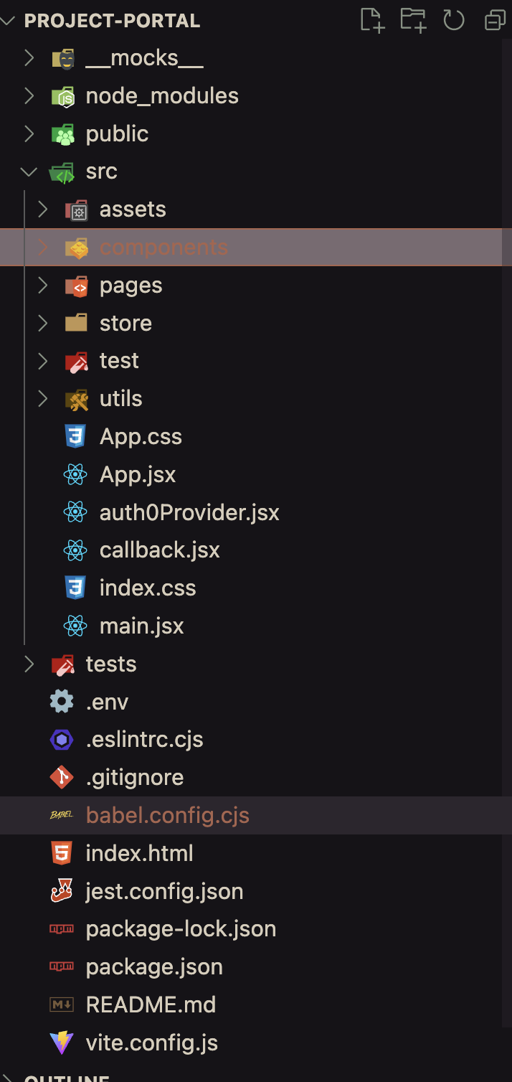
Software Design
Folder Structure:
Software Architecture
Framework: React, component-based structure
Using modified MVC
Main Pages: Dashboard, Landing, Account Registration, Login, Project Page
Component Examples:
Dashboard: Search Bar, Cards, Modal Popup
Project Page: Add functionality, analytics, task management

Slide 11
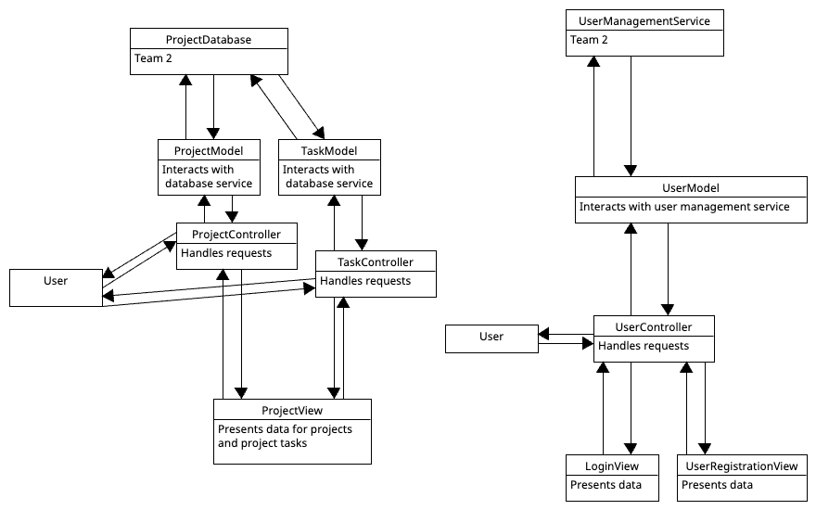
Architecture Diagram

Slide 12
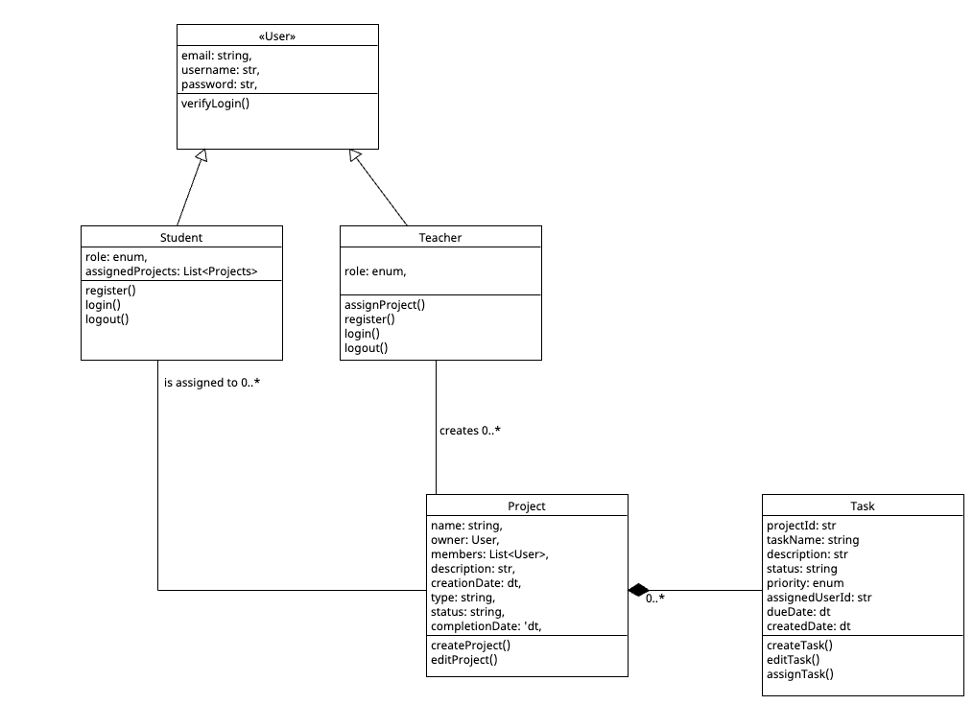
Class Diagram

Slide 13
UI Design
Design Concept: Minimalism and user-friendliness
Inspiration: Apple's design ethos
Key Elements: Clean lines, subtle animations, calming color palette
Tools: Figma for layout and wireframes, Canva for UI design

Slide 14
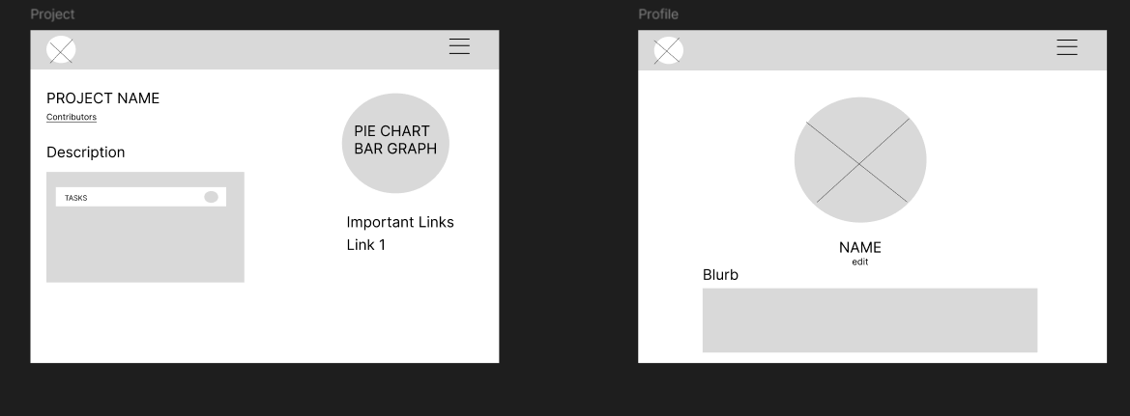
Wireframes

Slide 15
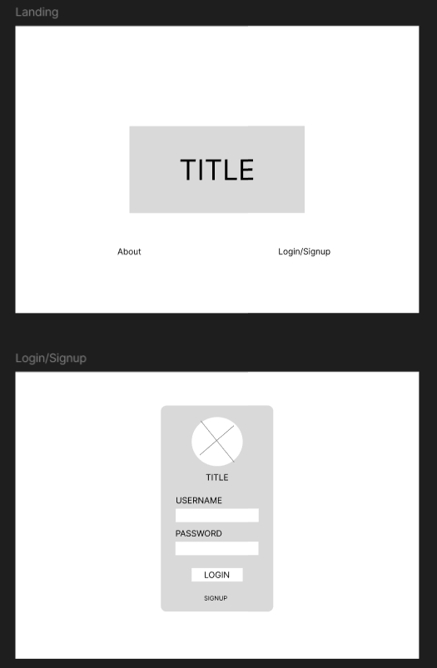
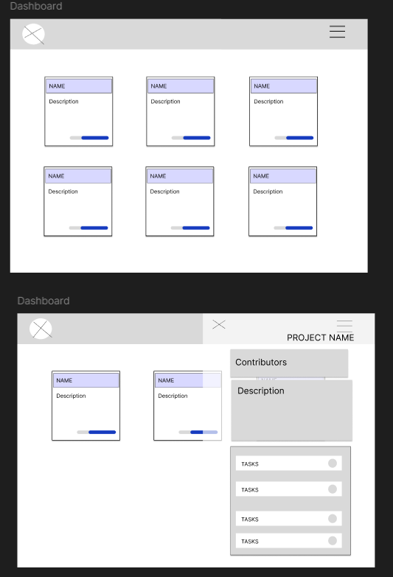
28 MAY, 2024

Slide 16
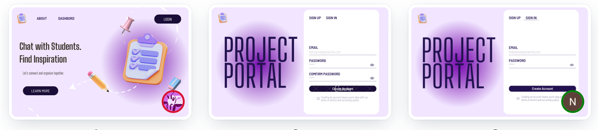
Canva Design

Slide 17
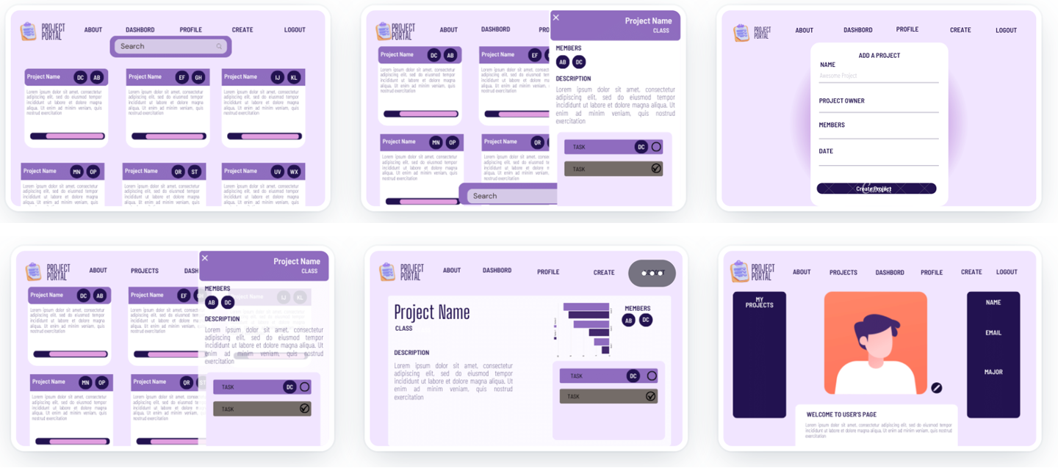
28 MAY, 2024

Slide 18
28 MAY, 2024

Slide 19
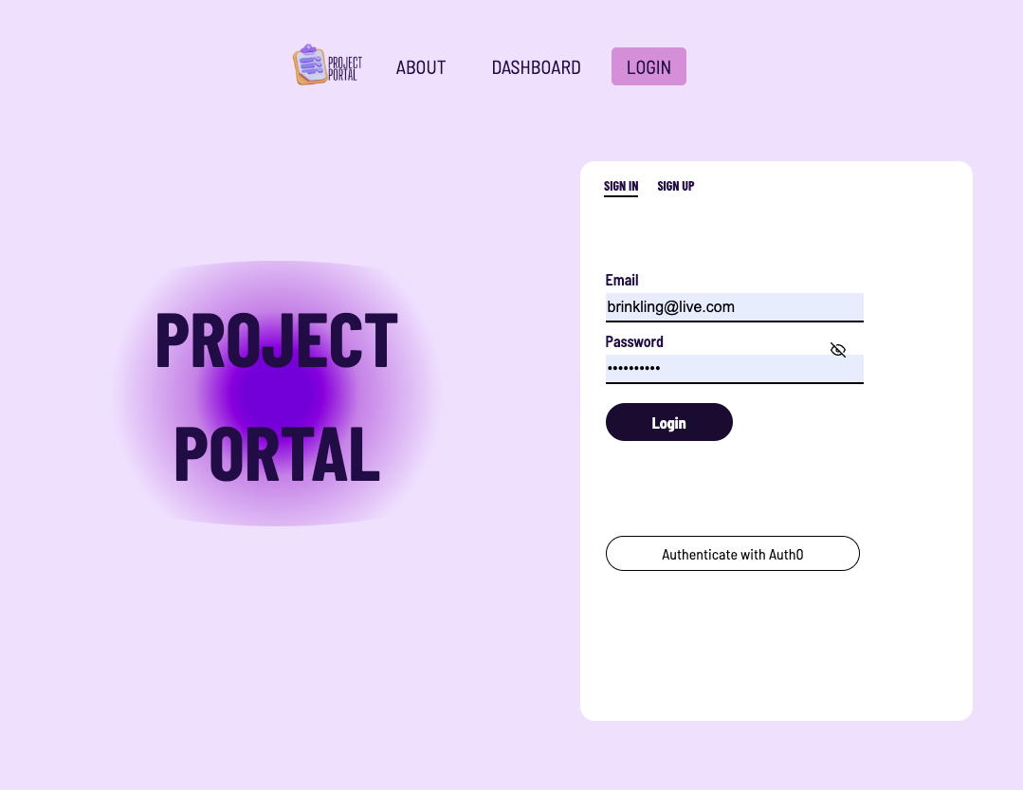
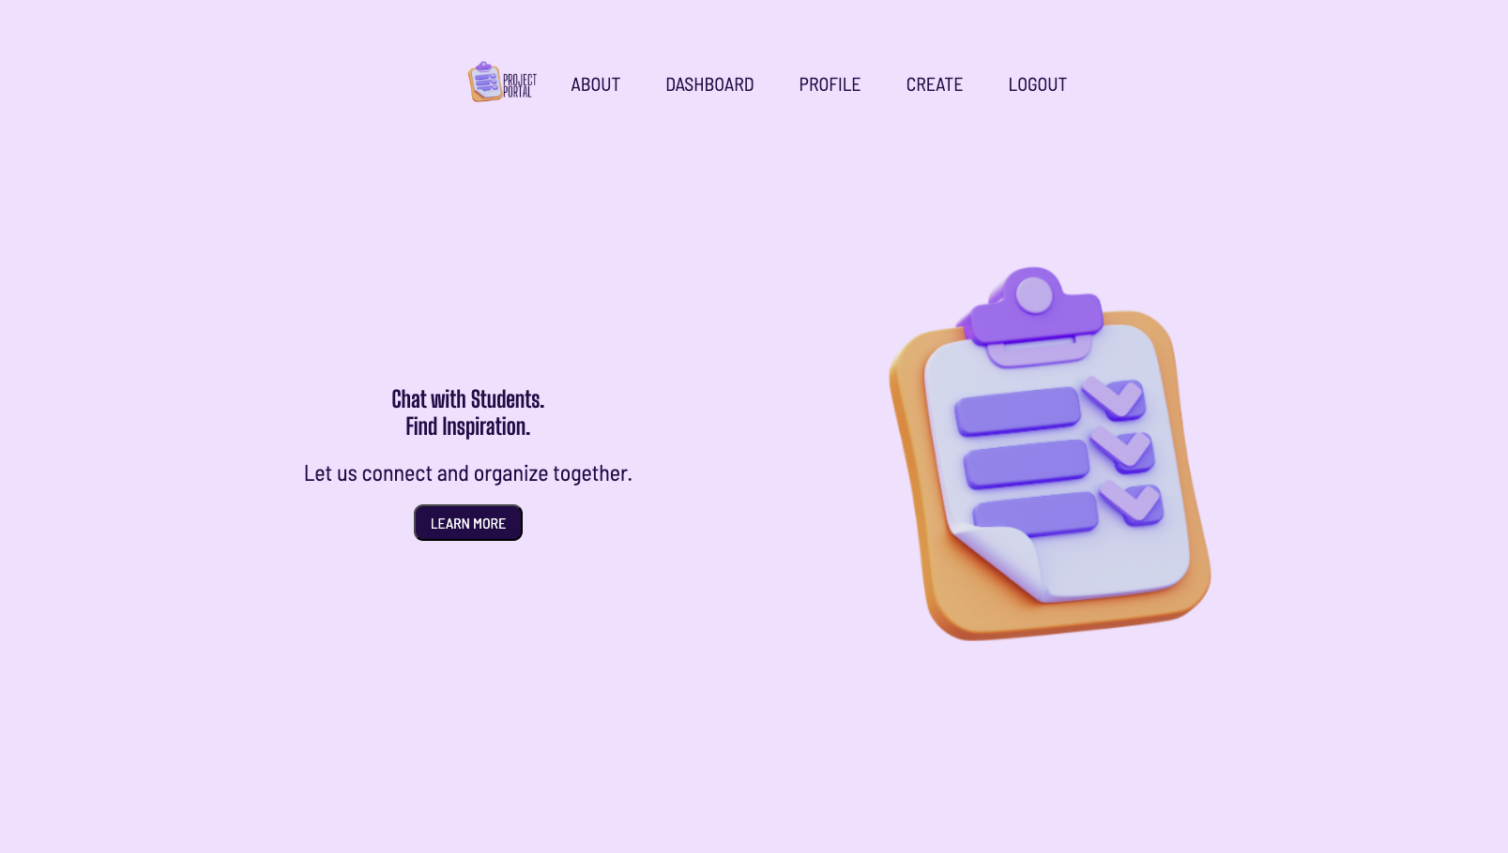
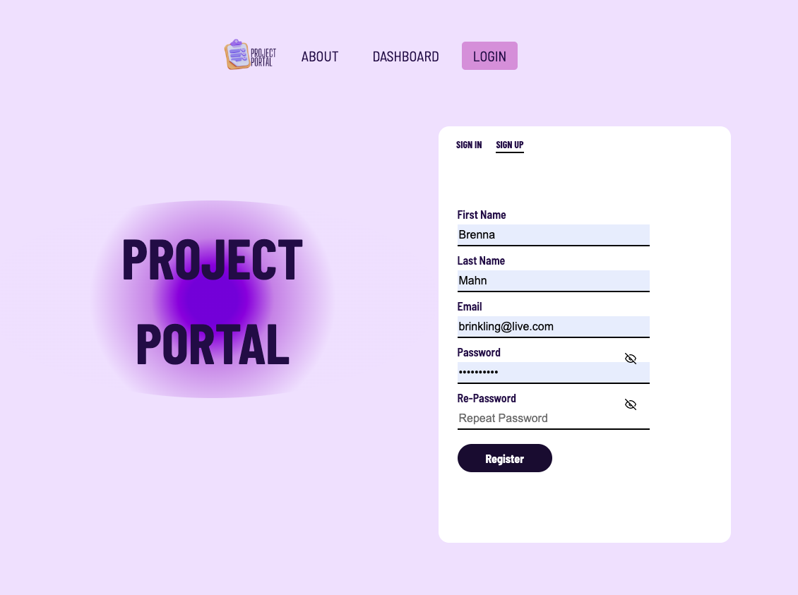
UI Implementation
28 MAY, 2024
Notes:
Lillian made the landing page and navigation bar and added the project theme, Brooke added the routing logic, Nati created the login and registration UI and created a login backend for us as well as hooked up team1’s Auth0 service option.

Slide 20
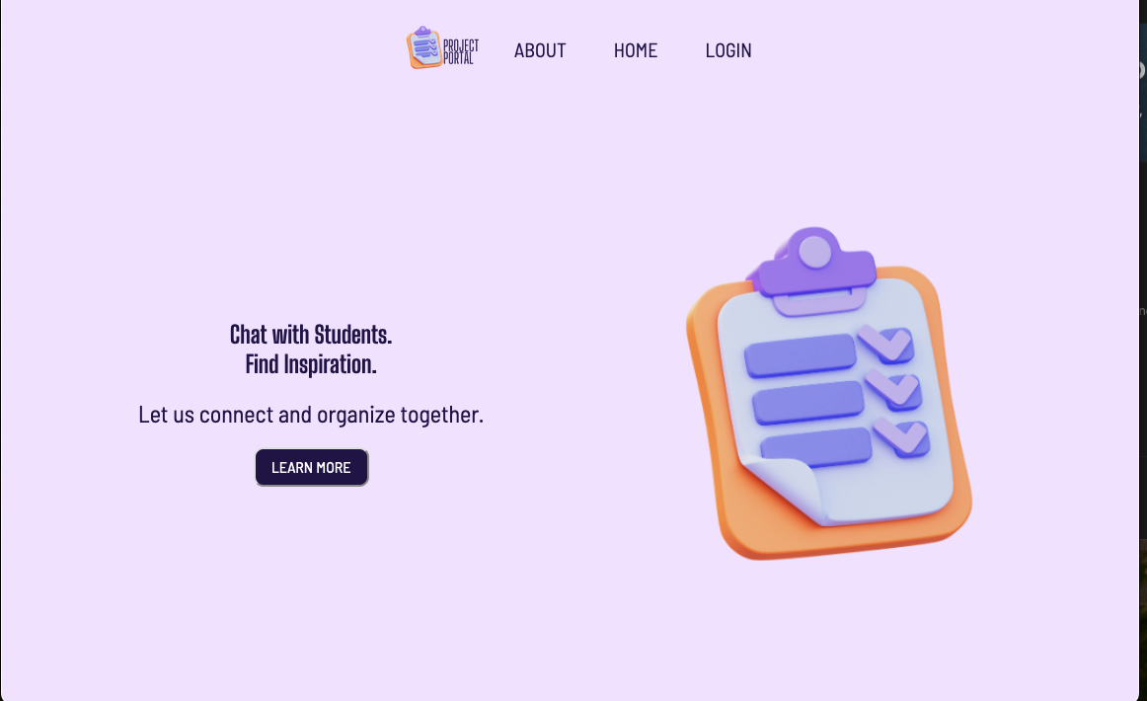
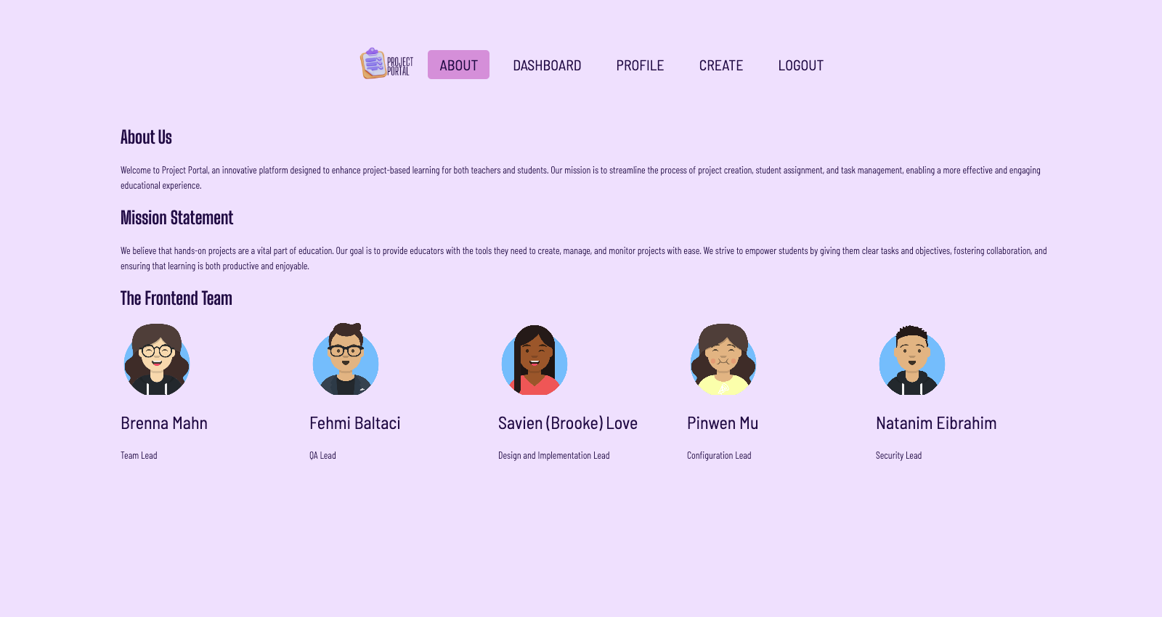
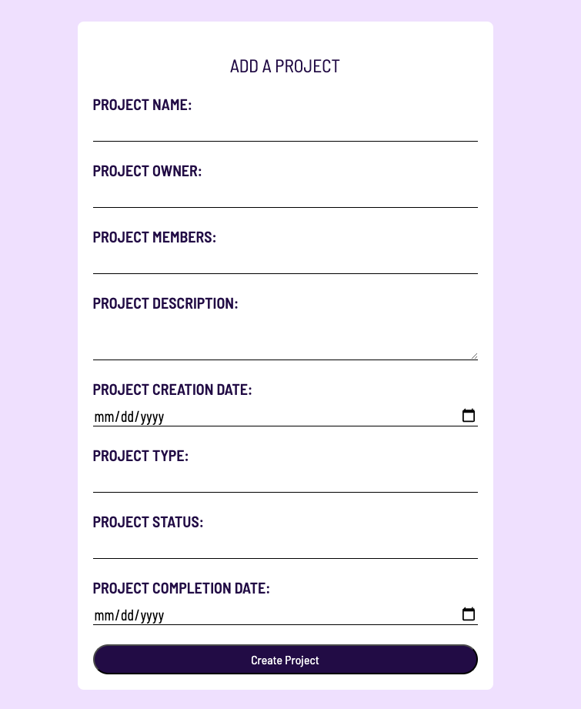
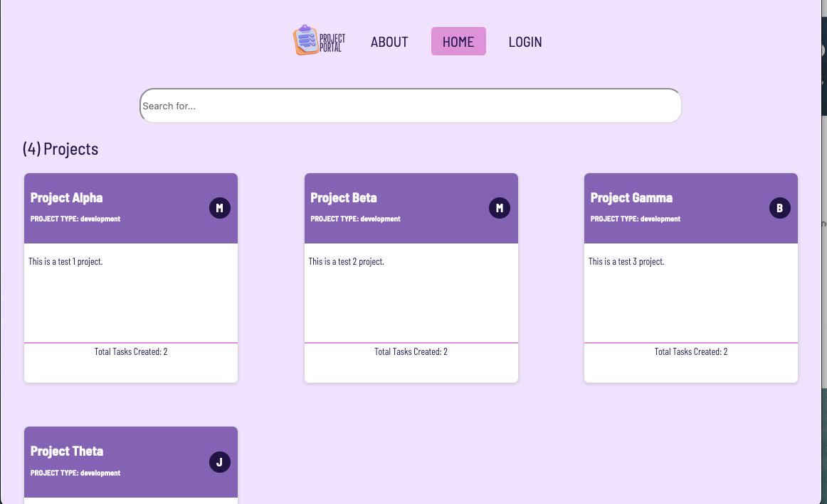
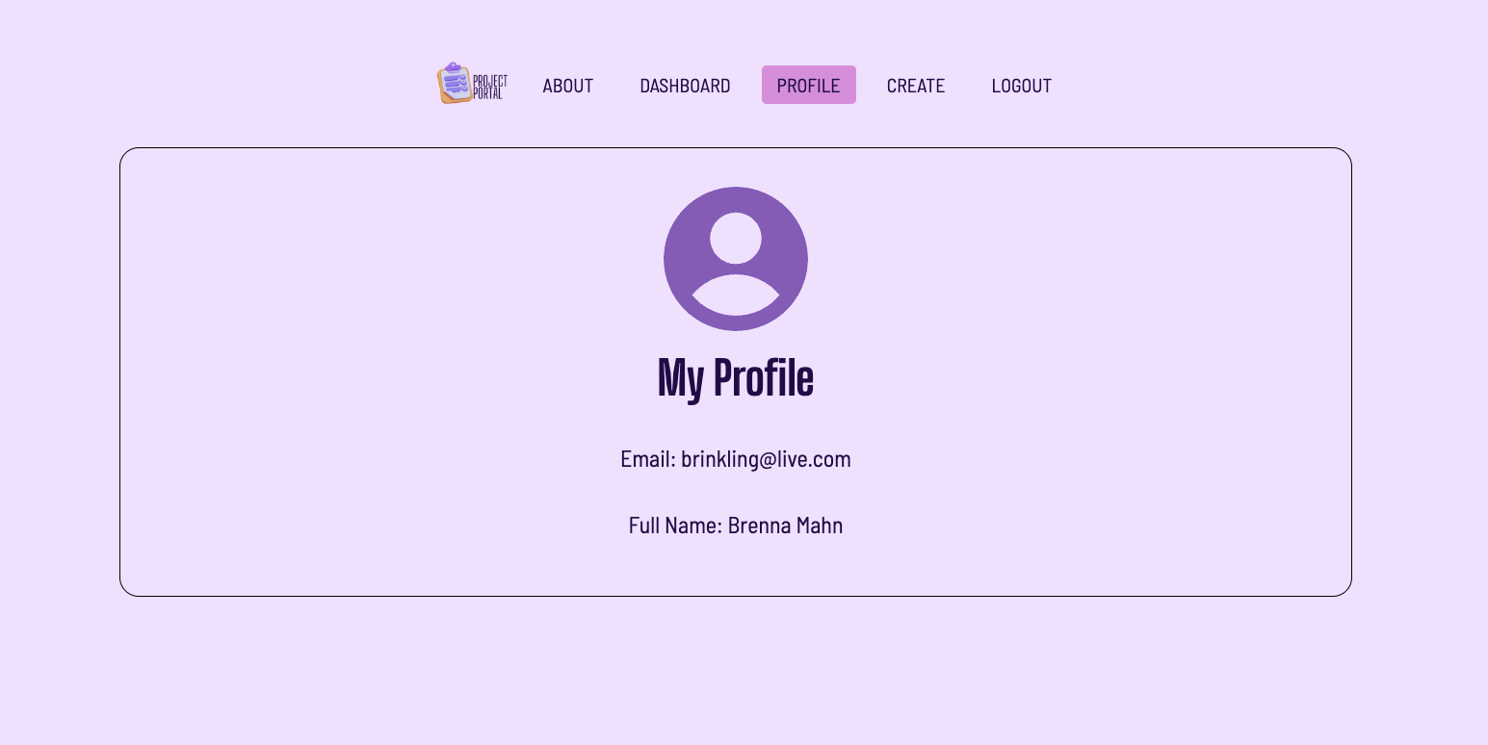
UI Execution
Notes:
Brenna made UI for these screens, Brooke wired up the project creation form to make it actually create a new project and display it on the dashboard, Nati added users to the project so the profile page could display it, everyone created their own avatar for the about page.

Slide 21
Security
As security is one of the main concerns of software applications, we have focused on implementing robust security measures to protect our application and users. To present the key security enhancements we have integrated into our project.
User Input Validation
Integrated Formik for managing form state
Implemented user input validation with Yup
Ensured robust validation rules to prevent invalid data entry
Enhanced user experience by providing real-time feedback on input errors.
User Input Sanitization
Implemented input sanitization to protect against CSRF (Cross-Site Request Forgery) attacks.
Sanitized user inputs to prevent XSS (Cross-Site Scripting) vulnerabilities.
Ensured all user data is properly sanitized before processing or storage.
Route Protection
Implemented route protection for sensitive areas of the application.
Utilized authentication checks to restrict access to certain routes.
Redirected unauthenticated users to the login page.
Enhanced application security by ensuring only authorized users can access protected routes.
Notes:
Lillian

Slide 22
Security
User Authentication : Ensuring secure and seamless user authentication is crucial for protecting user data and providing a smooth user experience.
Key user authentication features:
Dual Approach to Authentication:
Standard Authentication: Users can register by providing necessary inputs and subsequently log in to the platform.
Auth0 Integration: Implemented user authentication with Auth0, allowing users to be redirected to Auth0 for login and then redirected back to our platform.
State Management:
Used useState for local state management in components.
Used React-Redux to store sensitive user data and manage application-wide states securely.
Notes:
Lillian

Slide 23
Configuration Management
Tools
Version Control: Git and GitHub
IDE: Visual Studio Code (VS Code)
Frontend Frameworks/Libraries: React.js
Package Managers: npm
CI/CD: GitHub Actions
Containerization: Docker (didn’t use as planned)
Code Commit Guideline and Git Branching Strategy
Branching:
Iteration Branches: Each iteration of the project will have its own branch, named ‘iterX’.
Feature Branches: Each developer will create a branch for their current assigned ticket with the format: feature_<first initial last initial>_<feature name>.
Main Branch: The main branch will continue to hold the official release history. It will only be updated from iteration branches at the end of each successful iteration, ensuring that the code in main is always stable and production-ready.
Bugfix Branches: Branches named bugfix/ui-<bug_name> for urgent fixes
Pull Requests: Mandatory for every change, and must be reviewed by the Design & Implementation Leader or Team Leader before merging.
Commit Messages: Should include the type of change (feature, fix, update), a concise description, and the UI screen or component affected.
Notes:
Lillian

Slide 24
Deployment
AWS—---->Github Page
GitHub Pages offers simplicity and seamless GitHub integration for quick and free static site deployments
Link: https://bumetcs673.github.io/project-thisisteam4/
Notes:
Lillian

Slide 25
Testing Plan
Testing
Test-Driven Development (TDD)
Unit Testing
Manual Testing (Gherkin Language)
Automation Testing (Selenium-Behave, Postman)
Defect Management
Logging Defects
Backlog Review
Fixing and Testing Defects
Verification and Closure

Slide 26
Testing Execution Results
Automated testing implementation and results
Manual testing execution and results
Challenges to API testing that arose

Slide 27
FANTASTIC 5
Thank You

